Slide 1
Individual Homework
Burca Olivia – 912

Slide 2
Predicate Resolution
Exercise 1 → ∃ ¬ ∀ ≡
Transform the following formulas into prenex, Skolem and clausal normal forms.
1.2 : U = (∃x)(∀y)((∃z)¬ P(z) v (∃u)(R(x,u)→ (∀z)¬ Q(u,z)))

Slide 3
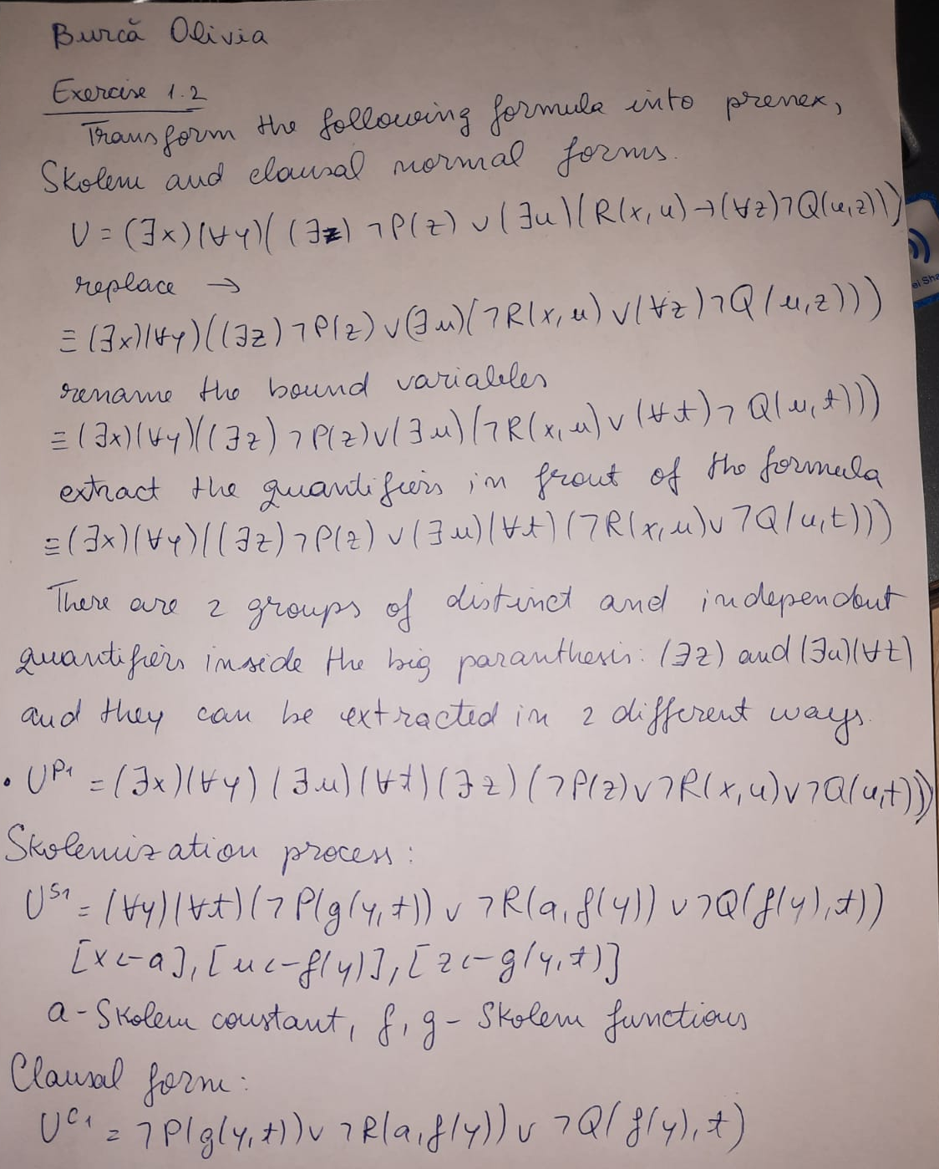
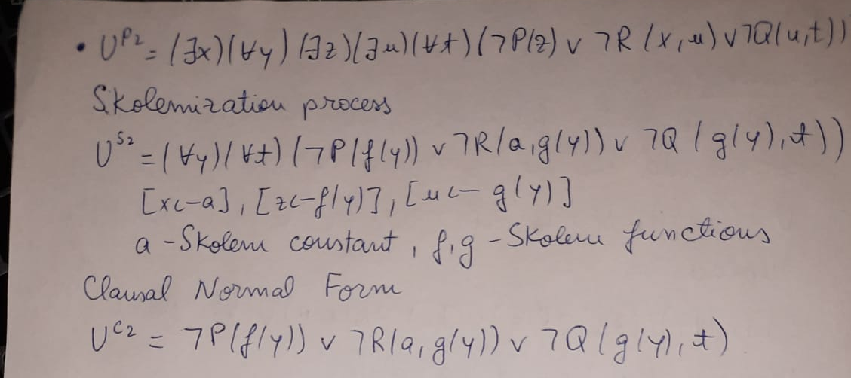
Handwritten Exercise

